Slide 1
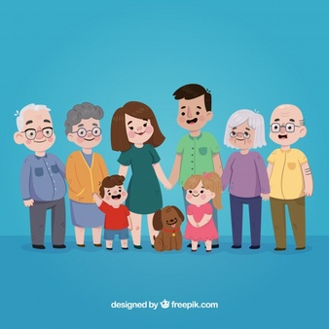
Project Team :Fiona Reeve ( Deputy Manager) Helen Cameron (Charge Nurse) Teresa Burnett (Principal Care Worker) Lindesay Irvine (Clinical Faculty) November 2018
Knowing you Knowing me project

Slide 2




Foundation of Nursing Studies
Patients First project supported by the Burdett Trust for Nursing
December 2016 – present (Jan 2019)
Project Lead: Dr Lindesay Irvine
Ashley Court Nursing Home
33 Craighouse Terrace,
Edinburgh
EH10 5LH
lirvine@qmu.ac.uk

Slide 3
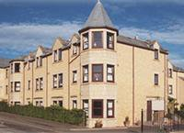
About Ashley Court Nursing Home
Ashley Court is a 52 Bed Nursing Home in
Edinburgh where we offer long term nursing
care for frail older people, with dedicated care
for people living with dementia and/or end of
life care. We also offer short term and respite
facilities for older people.
We have a Nurse Manager (a supernumerary role) and a Deputy Nurse Manager, we currently have one charge nurse who also has supernumerary time and have just employed a second charge nurse. We have 3 senior nurses, one on night duty with 5 staff nurses, 4 principal carers and 4 senior carers. Staffing levels are determined by the use of the indicator of relative need (I.O.R.N) care home model but as a home we always staff above our care inspectorate notice of 12/12. We staff at 13/13. This consists of two registered nurses and one principal carer or 3 registered nurses and 10 care staff.

Slide 4
Project key words
Person-centred records
Individualised person-centred care
Capturing ‘life world’
Older people’s story/stories
Care staff
Collaboration
Embedding person-centred approaches

Slide 5
Aim of the project
To re-develop the way we gather and record resident information/data. We wanted to achieve a person-centred approach to collecting the information and to generate knowledge by participating in the older person’s (resident’s) life world, creating a collaboration between the older person and the carers. Ultimately we are trying to achieve a ‘home from home’ for our residents where they feel safe, supported and able to express their individuality.

Slide 6
Objectives
To engage the nursing and care staff in collaborating with residents and relatives to design person-centred, individualised records to reflect the life world of the residents
To assist nursing and care staff to develop new knowledge and skills to listen and understand residents’ and families’ perspectives
To better understand the importance of working in collaboration with residents and families to improve the quality of care and view feedback as a positive contributor to that process
To develop useable and transferable documentation that clearly reflects the individual resident
To share these documents with the wider care home group and residential care home sector

Slide 7
Background to the project
Although we feel we provided good care, we did not feel we engaged effectively with the important aspects of the resident/person’s life and applied this in our practice, nor did we gain regular meaningful feedback regarding their continuing life with us.
We had a large amount of paperwork in relation to residents in terms of care plans, life stories, activity care plans and preferences and so on. However we did not actually use the information gathered on these documents to offer individualised person-centred care that is based on the resident’s background and life journey. This meant that, to a major extent, the resident’s care remained based on assumptions, routines and non-person-centred practice. Dewar and Nolan (2013) note that it is essential that staff do not assume how people want to be cared for. Other literature suggests that older people and their families should be involved in the planning, delivery and improvement of their care. This is a complex process but with person-centred care it is crucial to note that ‘No decision about me without me’ be the guiding philosophy to what we do (Robertson Pryde and Evans, 2014).

Slide 8
Background continued
To gain the information we required for the project we needed to focus on residents’ and families’ voices and feedback, to establish what is important to the residents and their families. This can be gained using a variety of methods which need to be suited to the population, age appropriate, person-centred and not care delivery centred (McCance et al., 2013) and include resident stories, walk-rounds, focus groups, on-line feedback, exploration of the residents journey, capturing the residents voice – family stories, collage, art work (NHS Institute for Innovation and Improvement, 2013a; 2013b; Dewar and Nolan, 2013).
At that time each resident had a key worker who gained as much information from the resident and their families as possible as soon as, or before the resident joined the care home however this did not truly involve the residents (Van Manen, 1990; Hickman et al., 2007). Its aim was to ensure that the forms were completed and thus met the regulatory requirements. There were monthly resident and family meetings but the paperwork is not part of these discussions.

Slide 9
Methods and approaches – what we did.
The project used a narrative based approach to develop a flexible and creative assessment of the resident’s needs and thus provide a foundation for a plan of care with redesign of required documentation. Integral to this is valuing views of older people (residents) as a basis for decision-making and assessment as a continuous process that allows a picture of the older person’s current situation, past experiences, perspectives and desires to emerge.
To achieve this we used experience based co-design approach which brings service users and staff together to share in the role of improving and developing care delivery (Kings Fund, 2013). As we wanted to engage residents, families and care staff in promoting a better care service, Dewing et al. (2014) suggests use of a four stage method (NHS Institute for Innovation and Improvement the experience) to enable service improvement.
Using this methodology we explored our current practices, identified barriers and issues related to the care delivered currently, developed a new approach to resident assessment and on-going care support with appropriate documentation and finally evaluated changes to the care planning approach and documentation (Manley et al., 2008; McCance et al., 2013; Buckley et al., 2014).

Slide 10
Methods and approaches – continued
Experience based co-design approach has 4 stages:
1. Capturing the current experience
2. Understanding the experience,
3. Improving the experience
4. Measuring the improvement
These provide the structure for the rest of this report.

Slide 11
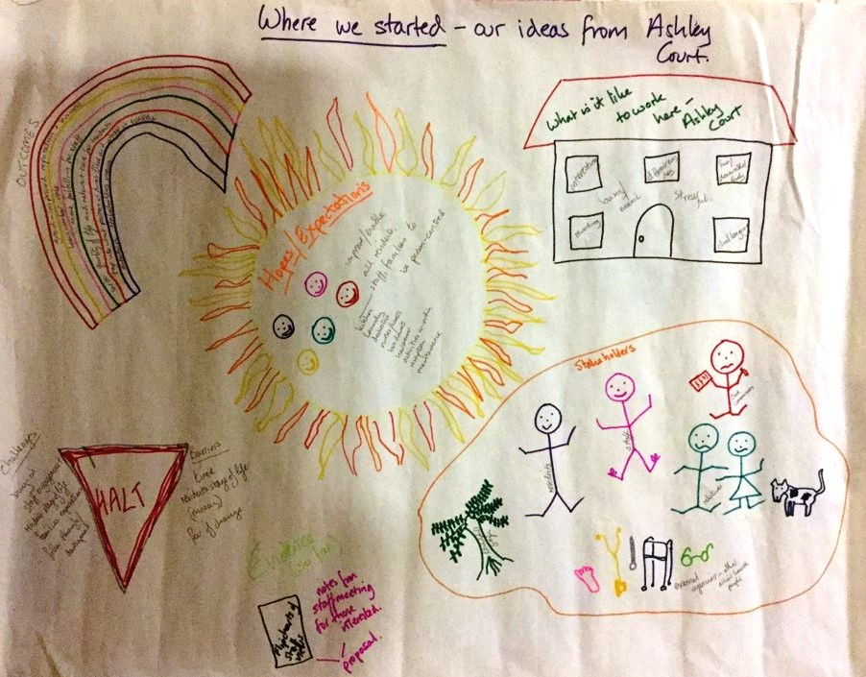
1. Capturing the current experience – Who are our key stakeholders?
Direct Stakeholders - residents, relatives,
all staff (care workers, nurses, laundry staff,
domestic service staff, chef, administrator,
secretary/reception staff, hairdresser, activities
staff, bus driver)
More indirect stakeholders - external agencies,
general practitioners, community nurses,
podiatrist, other allied health professionals,
directors of Randolphill (owners of the home)
Care group Care commission
We focussed on the direct stakeholders

Slide 12
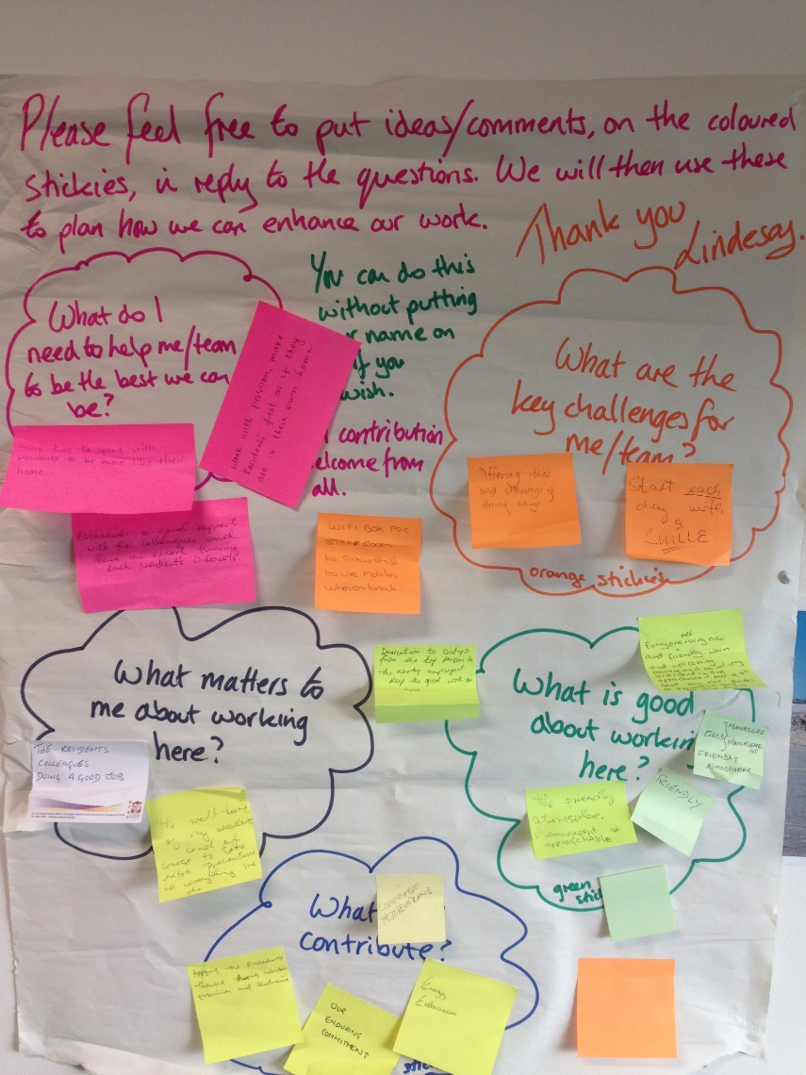
1a. Capturing the current experience - Gaining nursing and care staff views
Gaining staff views on their working culture, values and beliefs (Shaw et al., 2008) through use of flipcharts in the staff room
Themes emerged – commitment, more time to be with residents to be like their own homes, good rapport with colleagues, get to know each resident’s interests, well-being of residents
These were shared at an open staff meeting where it was agreed that the 2 things we would focus on were:
1. How can we find out truly what the residents like/are interested in?
2. How can we make it more like their home?

Slide 13
1b. Capturing the current experience - Key stakeholder drop in
A key stakeholder drop in event was held in January 2017 (2pm- 8pm)
Individual invitations were sent to all residents, relatives and staff. A poster inviting all to attend was placed in strategic places in the care home. Extra staff were employed on the day to allow other staff to attend. Tea and cakes were provided all through the event
15 relatives, 2 residents and 3 staff attended throughout the event
Each new arrival was greeted by a project team member who offered refreshment, gave an overview of the project, encouraged them to add their ideas, stickies etc to the flipcharts around the room, and discussed how we might gain ‘life stories’ as a means of changing the focus of the current paperwork

Slide 14
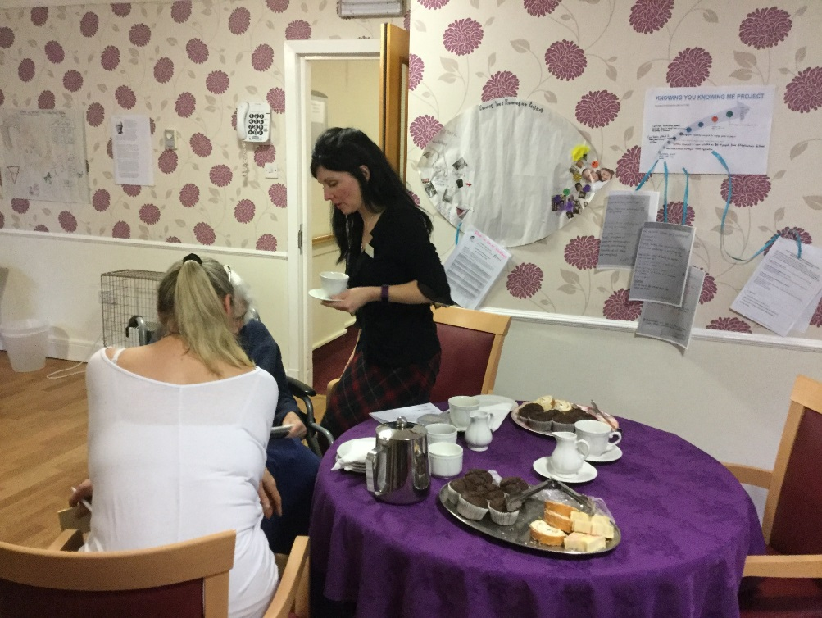
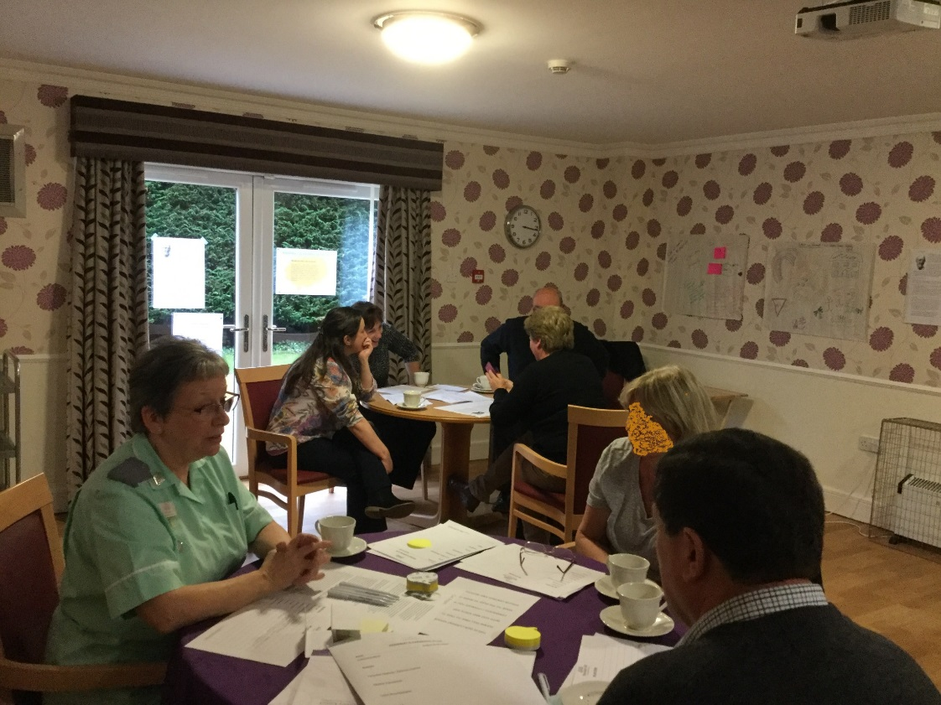
Key stakeholder drop in - event continued.
All stayed as long as they wishes and contributed as much as they wished. Confidentiality and anonymity of people’s views were stressed

Slide 15
Key stakeholder drop in – Ideas and suggestions made
Drop in café – show and tell, story telling
Photos of staff for relatives and residents
Personal plans in first person
‘Buddy’ approach for new relatives by more long standing relatives
Life history request to relatives/residents before admission if possible
On-line forum and information site
Scrapbooks rather than folders
One page profiles
Change terminology we use
Information of project progress
“We need to get to know each other first before we share information so we can trust you”

Slide 16
2a. Understanding the experience - Project team reflection on the event
We asked ourselves: what went well, did not go well, what did we learn, how does this help us?
This in effect was a sort of focus group debrief and we established that we were all pleased at the support from relatives and several had discussed it further with staff after the event. Some of us felt quite emotional about what we had learnt from relatives and residents on many levels
Evidence from some staff quotes:
“found it thought provoking about how much we assume people are OK about coming into care and know what will happen”
“never considered that relatives might not wish to share details of their families immediately because they don’t know if they can trust us with that information”
“having spoken with X, discovered what it felt like to come into care, made me want to cry”
Through discussion we realised that people may not want to share information in the first immediate days post admission – they need to be able to trust us and also get to know us as people and we were quite humbled by this thought. We needed to consider this in our plans.

Slide 17
2b. Understanding the experience - Project team reflection on the event
The room arrangement worked well and positive comments were made to us about it by relatives
“it is great to be asked to become involved in what the care home is doing”
“liked how we were able to talk to other relatives too, and also put ideas up on charts but be a bit anonymous in case they seem silly”
We discussed our disappointment in the lack of staff attendance (only 3 dropped in briefly but did not engage in discussion or conversation - just looked at the information on the walls and left again) particularly as effort had been made to maximise staff levels to allow attendance. We decided we had to rethink this aspect to try and engender engagement.

Slide 18
3a. Improving the experience
The key stakeholder event generated many views and ideas from all the attendees; these were grouped into various actions.
- Knowing you: one page profiles, scrapbooks and first person paper work, capture the life story as an on-going process, life history before admission if possible
- Knowing me: one page profiles, staff photo boards, change language used, staff workshop
- Keep informed: on-going updates of project via variety of means
This also allowed us to identify what would be evidence for evaluating the success of the project - for example one page profiles, photos, use of language and so on.
We decided we had not gained what we had hoped in terms of views on the paperwork being used and how we might change it, therefore we would review this approach and rethink how we could record the necessary information. However we were energised by the event and this helped identify areas where we needed to focus our attention in terms of practice development internally
Our evaluation evidence will be presented under section 4 Measuring the improvement (below)

Slide 19
3b.Improving the experience
A meeting with our FoNS facilitator helped us to keep on track and focus on the process rather than output. We identified several aspects to take forward based on the views and ideas generated from the stakeholder event and each member of the project team selected the area they would lead on. These areas were:
Sharing the project and its progress
Discussing and agreeing with other staff the changes in terminology, use of photos and one page profiles
Establishing a regular café event when the new residents lounge and kitchen were completed
Changing the language used on forms and at meetings, replacing it with more relaxed terms and first person – for example a ‘get together’ rather than a meeting, and evaluate effect on attendance and contribution
Identifying dates to hold further staff events as a means of engaging them in all processes

Slide 20
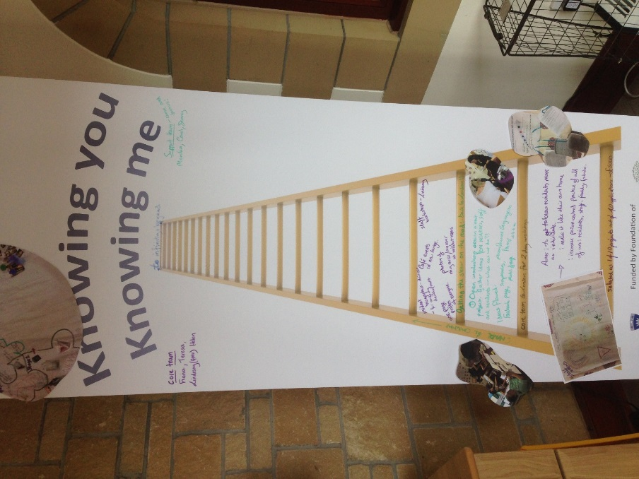
3c.Improving the experience
Sharing the project and its progress: a project banner with the ladder of progress was purchased using some of the FoNS bursary. This was placed in the entrance foyer of the home, as all staff, relatives, visitors and residents use this entrance and therefore it would be seen regularly. The banner is updated regularly following any major changes or developments. Project updates are also placed on the staff noticeboard in the staff room. The project team debated setting up a Facebook site or similar but at the present have decided this was too complex due to the issues of controlled access and confidentiality.

Slide 21
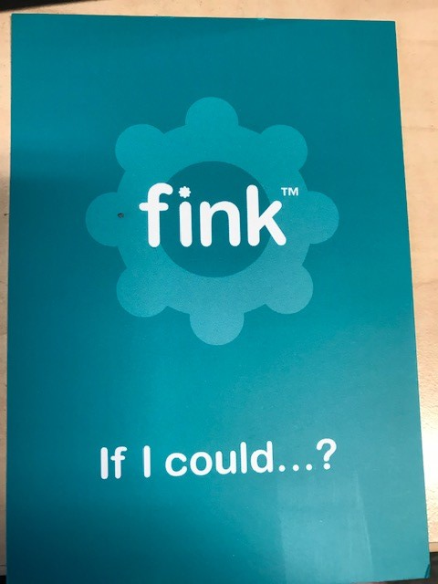
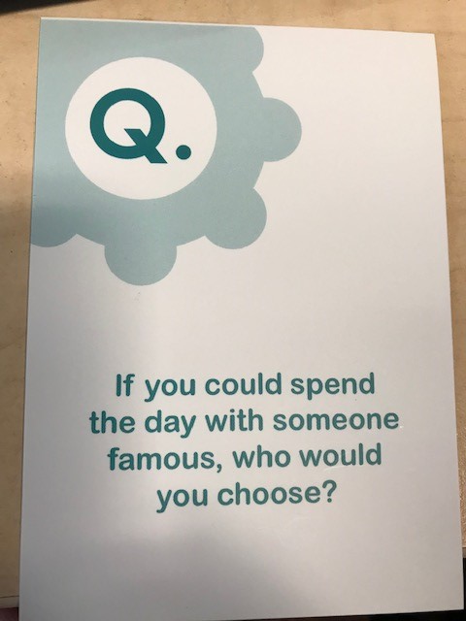
3d. Improving the experience
Staff engagement: In an effort to engage more staff in the project (particularly the ‘knowing me’ aspect) a staff get together session was held. All staff were invited individually by letter and were paid for their time if they were not rostered on duty that day (funded by the care home group). We also changed the language from staff meeting to a get together to reduce the formality of it.
This resulted in 15 staff attending. An update on the project so far was given by the Deputy Manager. This was followed by using the FINK cards (conversation cards that start discussions about people as individuals. These cards are often used with people with dementia and also to construct one-page profiles (www.findcards.com).

Slide 22
3e. Improving the experience
Staff engagement continued: The use of “Fink Cards” helped staff get to know each other a bit better as people rather than staff members. Then a discussion was held about the ideas generated by the first open stakeholder event and the way forward in terms of our language and the one page profiles.
Things agreed in this discussion were:
To use my nurse and my carer, to replace key worker and key nurse as terms, and to have one page profiles of these in each residents room along with the resident’s profile. The residents will choose where these are situated in the room
To set up photo boards on all floors with the staff photos and names
All staff were keen to try the new first person approach to the paperwork – an example of this is “My name is … but I like to be called ... I particularly enjoy reading and listening to the radio but am not so keen on the TV being on”
A follow on from this event was one carer set up an art group with the residents and another took forward the idea of a lunch club café (these were people not directly involved in the project team).

Slide 23
3f.Improving the experience
Relative and family get togethers: Relatives meetings are held on a regular basis, however traditionally attendance has always been small – between 2-4 people. Following the key stakeholder drop in event it was decided to rename the meetings as a “family and relatives get together”. This resulted in 12 relatives attending – it was thought this maybe the result of people being asked to be involved and people feeling that the event would be less formal and ideas and suggestions would be listened to.
What happened at the “get together”? Relatives stated that they really liked the personal plans being in the first person and that it really reflected their relative. Three relatives volunteered to start scrapbooks with their family member and they also suggested, based on the chat to each other at the open event, that they would encourage a buddy system for new relatives. One also suggested they could meet relatives prior to the admission of their family member to help with the transition. Other ideas from this get together were an information leaflet for prospective relatives.

Slide 24
4a.Measuring the improvement
Staff survey: Nursing and care staff were encouraged to undertake the survey using the Customer Research Technology (CRT) electronic survey system which had been placed in the staff room (2017 for a month). This survey focussed on aspects of person-centred approaches and their views of these. Results from this showed an increased knowledge and practice of person-centred approaches as compared to the previous survey done in 2016 before the project started
Questionaire: A questionnaire regarding the new personal plans was also sent to nursing and care staff for their views on its use and impact. Response level was poor (7 returned) and we need to consider other more organic ways of getting feedback
Narrative feedback: However quotes from the open questions showed the new plans were seen positively.
“so much helpful information about the person that care is better than before”
“more person-centred and allows me to really understand the resident”
“better understanding of resident’s life and how we can work with them”
“person-centred approach makes an effort to connect staff and residents as people feel residents are chatting to us about how they would like to be looked after”
“in first person so plan is delivered from resident’s point of view”

Slide 25
4b.Measuring the improvement
Feedback from staff: Senior staff undertake social supervision sessions on a one-to-one with their team workers as part of professional development. Two senior workers reported that some of their team had spontaneously raised the topic of the culture on their ‘floor’ saying that they felt they were seen more as people now not just a staff member and that they were observing changes in how the team talked and worked with each other, with more respect and challenging use of language when it seemed the person-centred focus was missing.
Care Inspectorate inspection: An unplanned inspection by the care inspectorate in February 2018 also yielded evidence in this respect – with the senior inspector saying to project lead that “as soon as they walked in the door of the home they could tell something had changed”. They also verbally reported that on walking around the home they observed much more resident/staff interaction on a personal level; and they noted in their formal report “the culture encourages creative contributions from staff to suggest improvement in the running of the home”. The grading of the home went from 5 years of being graded 4 – good for quality of care and support and quality of environment to grade 5 – very good.
Although one cannot categorically state the project has caused this result, it could be surmised that it has had some impact on gaining the increased rating.

Slide 26
4c.Measuring the improvement cont:
Residents lunch club: This was taken forward by a care worker who loves to cook. It is held once a month using the residents kitchen and the dining area. A particularly successful event was the brunch as this drew in more male residents as well as females. The residents contributed to the preparing and cooking of a “full Scottish cooked breakfast” in the kitchen, so many residents attended that extra tables and chairs had to be moved into the room to allow them all to take part. Staff joined them to eat the brunch. Comments from residents after the event:
“felt I had a sense of purpose again because I was able to cook and clear up a meal”
“it was great, even the handyman joined us for a cup of tea – felt like a real family”

Slide 27
4d.Measuring the improvement
Review of the care plans: Evidence sought from residents’ care plans regarding pre and post implementation of project effects. The data from these suggested that for two residents, the improved personal information collected and used had resulted in a change of practice in managing
the anxieties the resident suffered thus reduced need for drug therapy
mobility challenges and use of a zimmer frame reducing falls for a resident
Other ongoing evidence is being continually collected.

Slide 28
Conclusion
The embedding of person-centred practices within the care home has begun with many more staff and residents working together to achieve a person-centred environment.
Since concluding the formal part of the project, further person-centred practices have evolved – a prime example being that all residents were asked by their key carer, what they would like to receive as a Christmas gift from the care home. This allowed each resident to have a personal gift bought for them by either the key carer or the management team rather than the previous approach of all getting a similar gift.

Slide 29
Key learning for the project team:
Gaining involvement using multiple approaches is vital
Keeping motivation and momentum going, and celebrating small successes is a good thing
Having a lead facilitator makes the process more manageable

Slide 30
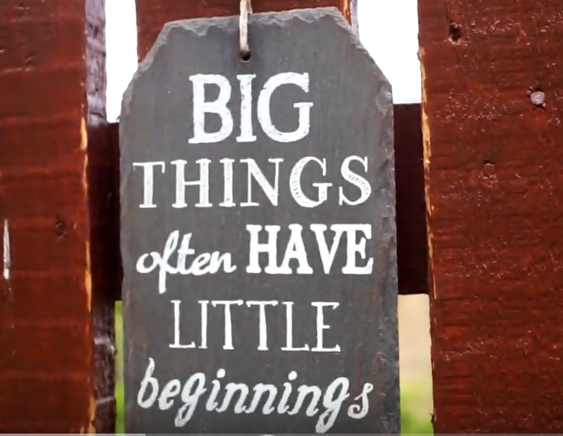
This video summarises the project: https://youtu.be/OW_48E7d7w0

