Slide 1



“Optimising your recovery”
Nurse-led innovation to reduce on-day theatre cancellations within Orthopaedics
Lisa Hacker (Project Lead) Staff Nurse, Orthopaedic Outpatients Department, The Royal Bournemouth Hospital, Deputy Clinical Leader Avril Sharman and Health Care Assistant Lauren Hacker
Contact: Lisa.Hacker@rbch.nhs.uk
Acknowledgements: To FoNS and the Burdett Trust for Nursing for supporting the development, implementation and dissemination of this project
Notes:
Hello, my name is Lisa and this is my colleague Lauren. We both work in the Orthopaedic Outpatient Department at the Royal Bournemouth Hospital. On average, we see around 700 elective patients per week under the care of 14 specialised Consultants and their teams. Within the directorate, we carry out approximately 200 surgical procedures per week.
We would like to present to you our nurse-led innovation to reduce on-day theatre cancellations within orthopaedics.

Slide 2
Background
The Orthopaedic Outpatients Department within the Royal Bournemouth County Hospital (RBCH) in Dorset manages orthopaedic patients from a large demographic, across the counties of Hampshire and Dorset and works collaboratively with the elective inpatients Orthopaedic Unit at the RBCH.
Our core team for this project were Staff Nurse Lisa Hacker (Lead), Deputy Clinical Leader Avril Sharman and Health Care Assistant Lauren Hacker. We decided to do this as we felt the patients journey through our department from start to finish could be improved.

Slide 3
Setting
Patients and service users visit our department for a variety of appointments, including consultant review, pre-operative assessment, wound clinics, therapy review, plaster room services and post operative check-ups. Patients can attend numerous times depending on their care pathway. In our nurse led clinics, we see post operative patients (depending on a set criteria) regarding wound management. Telephone reviews are also carried out for patients who require specific follow up.
Nurses work autonomously within these agreed responsibilities and refer patients or discharge them from our services as appropriate. The department sees on average 700 patients every week across all clinics. In addition, to manage increased demand for the service, we now run ad hoc twilight and weekend sessions.

Slide 4
What was the impetus for the project?
It was discovered that during November 2015, there were 75 theatre slots cancelled, either on the day or the day before surgery, which couldn’t be refilled at such short notice.
Financially, this equated to £36,000 for every 6 patients who were having major orthopaedic procedures, which if saved would be the equivalent of an experienced full time staff nurse for a year.
The reasons for cancellations varied from patient to patient with some simply forgetting the date. However another reason was the length of time between the final outpatients visit and the surgery date; our outpatients service is predominantly ‘a one stop service’ and the time between listing for surgery and the operation date could be up to 10 weeks. During this time, vital information can be lost or forgotten meaning surgery cannot go ahead. The significance is that patients would always make pre and post operative plans which would then be wasted, not to mention the stress, disappointment and financial upset cancellations caused.

Slide 5
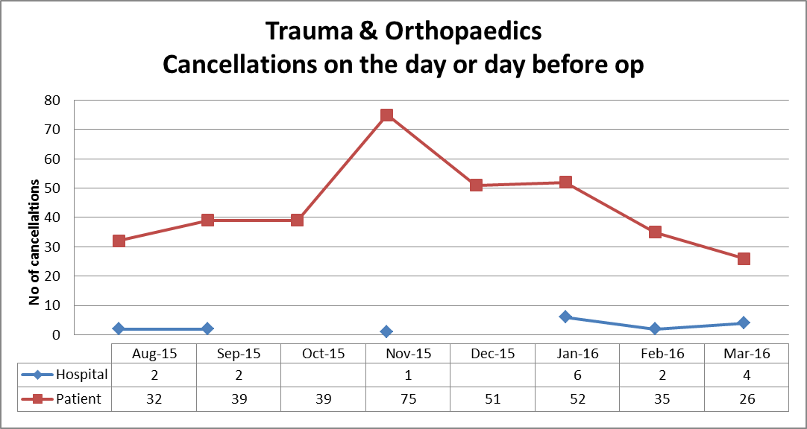
Theatre cancellations
Notes:
So, what was the problem we faced?
Back in 2015, it was recognised both within the directorate and amongst senior managers that there was a significant problem relating to the number of patients cancelled on the day of or the day before surgery as a result of patients not fulfilling the RBH criteria upon admission. This ultimately impacted on theatre utilisation as there was a huge number of wasted theatre slots which could have been avoided. The catalyst for action occurred in November 2015, when a total of 75 cancellations on the day/day before surgery were recorded. We wanted to see what we could do about this, so came up with the simple idea of calling patients a few days before their admission to check that they were still planning to attend, that they were fit and ready for surgery as well as answer any questions they may have. If during these calls, a patient was unable to attend, we were then able to link with the admissions team to ensure that the theatre slot is backfilled with another patient to fully utilise the time available to us. This is particularly important as due to winter pressures in particular, our elective service can be adversely affected so the more opportunities to fully utilise our operating capacity, the better!
The phone calls themselves also helped us to clarify the reasons as to why patients were being cancelled on the day. Several themes arose including:
Pre-op antibiotic use
Coughs and colds
Open wounds
Patients being overloaded with information and therefore not retaining key messages

Slide 6
Aim of the project
Overall we aimed to improve the patient journey, initially for people undergoing lower limb surgery.
We also hoped to:
Have input in a foot and ankle Information booklet written by a consultant to give to patients during the pre operative period
Develop quality reader (QR) links put on patients information linking further reading about procedures for patients’ own use
Raise awareness with GPs ensure they are familiar with the surgical criteria and policies
All this would provide a foundation for a positive experience giving both emotional and mechanical success thus corporately improving CQC responses and overall ratings.

Slide 7
Objectives of the project
To formalise nurse led phone call for patients pre-operatively
To run a lower limb education class for pre op patients
To provide patient information in an effective way using various methods
To access GPs through PCG meetings or directly
To get IT technology for QR links
Within the first few months of the project starting, it became apparent that we were too ambitious in our objectives given the timescale for initiating any change. Following discussion with our corporate improvements team, we revised and prioritised our objectives, therefore some remain to be met and are ongoing.

Slide 8
Methods and approaches
Methods and approaches | Dates | Content
Core team meetings | Started August 2016 and held monthly | Discussed project commitment Possible improvements Development of action plans And activity against action plans
Core team meetings with department managers and colleagues | Started October 2016 and held regularly | Discussion about confirmed aims/objectives and extended roles, discussed developing a foot class, pre and post op phone calls, new foot book input with consultant. Core team started an ongoing time line of the project for department colleagues to view.
Project Lead attended knee class | January 2017 | Attended and observed how an established knee class was presented by corporate physiotherapists
Core team meeting with department managers and corporate improvements team | Started January 2017 and held regularly | Confirmed pilot foot class date, developed a patients invitation and evaluation sheet. We agreed project action plans and made spreadsheet as a record
Pilot Foot class 2nd Foot class | February 2017 August 2017 | Class presented by core team members and evaluated by patients
Stakeholders meeting with department leaders, managers and extended stakeholders (OPD) | March 2017 | Group discussion clarifying documentation used for phone calls, review advice given over the phone, development of an SOP, review pilot class evaluations
Audit team meet with team lead | June 2017 | Developed new phone call spreadsheet and took to authorising panel

Slide 9
Nurse led phone calls
We initially started pre operative phone calls on an ad-hoc basis where we would fit them into spare minutes in the day. However, we saw dips and peaks in the success so decided to make this a dedicated task which showed great improvement in re-filling cancellation slots. Now we employ a non medical role 30 hours a week to do phone calls and the contact rate is around 98%, with around 5 patients a month being cancelled on the day
We ask patients various questions (see next slide) to confirm their health status pre operatively. Because the phone call is carried out by a non medical person any issues flagged up are assessed by a qualified nurse who takes over the phone call
In evaluation, we have a 98% attempt to contact rate with a 96% actual contact. This has seen the number of on day cancellations drop to from 75 per month (November 2015) to 5 patients (June 2018)

Slide 10
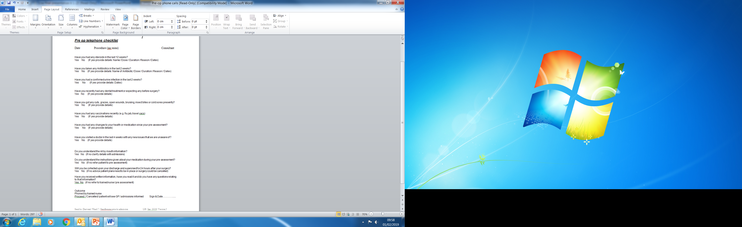
Questions asked during pre operative phone call
Notes:
This is the questionnaire the telephonist asks all contacted pre op patients. It highlights issues which could cancel surgery.

Slide 11
Introduction of nurse led foot class
In order to increase the information available for patients prior to surgery, a foot class was piloted. Patients who were awaiting lower limb surgery were invited to attend. A nurse led power point presentation was used to deliver pre operative advice including criteria for surgery (including medication use) that was required on admission day
Information of post operative care was also shared to try and achieve optimum recovery. Examples of possible footwear patients may have been discharged with, was also shared

Slide 12
Evaluation of nurse led foot classes
The evaluations showed that although patients found the sessions informative, they expected a doctor to be in attendance and wanted to discuss individual cases which wasn’t possible for confidentiality reasons
The outcome (after several pilot classes) was that the information shared at the foot classes could be delivered via information screens within the Orthopaedic Outpatients waiting room instead. This meant that patients didn’t have to make a special visit for the class, and the department didn’t have to stay open after the usual working day had finished

Slide 13

Our Achievements
Changes in standard practice
Pre-admission phone calls, educational classes, detailed patient information booklets
Most importantly…..Optimised patient journey
But also :
Improved theatre utilisation – less wastage
Built strong relationships with key stakeholders
Raised profile of Orthopaedics within the Trust
Increased directorate budget
Notes:
Achievements
We have changed practice with our area. Our daily staff allocations book now includes pre op phone calls. most weeks we call around 200 patients 2-3 days prior to their op
We set up a foot class for pre-op patients giving information on what to expect, the patient can have a look at some crutches, given practical advice pain relief, rest and exercise on a visit to the Sandbourne.
We write blogs for the FoNS website which are published. Embracing new tech.
We have made stakeholder connections and they in turn have raised our profile in professional circles they move in. And it turns out a lot of people are talking about Orthopaedic.
And of course more importantly this has changed our patient journey. Our patients have told us they like being called by us, they feel reassured, and they can ask questions and get answers from an orthopaedic nurse. The patients are prepared and we have met their expectations.

Slide 14
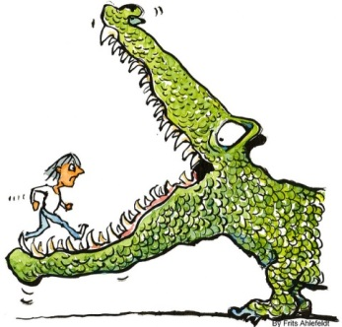
The Challenges
Historical culture within the department
Time available for clinical staff to participate
Seasonal demands and associated staff allocation
Loads of ideas and therefore difficult to prioritise
Utilisation of technology
Notes:
We have faced a number of challenges during this project. These include:
Historical culture within the department. People didn’t want or feel the need to change
Lack of time available for clinical staff to take time out of their ‘day job’ to undertake phone calls, particularly if patient’s aren’t at home to receive the calls and therefore need to be called again at a different time. This is also affected by OOPD nursing rotas as some staff are part-time
Seasonal demands across the Trust, resulting in varying staff allocation as OOPD can be moved to Orthopaedic wards to provide support. A pertinent example is when it snowed recently. As people were unable to get into hospital, there were staff shortages and therefore no one available to call patients pre-admission. As a result, we saw an increase in the number of on-day cancellations the following week
Loads of ideas were raised during the QI process. It took some time trying to prioritise those which were most achievable
Role changes during project
Use of technology both amongst staff and patients. A lot of our patients (particularly those requiring hip and knee surgery) are quite elderly and there is an assumption that they have access to and an understanding of technology, which isn’t always the case!

Slide 15
Next steps
Increase use of electronic media, including via the FoNS website
Discussions underway with Trust to incorporate the pre op questionnaire onto the Patient Care Record System so we would only chase up patients who have not accessed this
Ongoing training for staff – communication and understanding of medical concerns ahead of surgical admission
Pre-op phone calls – changes in practice whereby patients are now phoned 2 days prior to admission
Work underway to update internet pages on corporate website to support patient expectations
Foot information booklet written in collaboration with the foot and ankle consultant
Have the foot class powerpoint rolling on the information screens in the waiting room on foot class days
This is an ongoing, iterative programme of improvement and as such, we see ourselves on a continuous journey
Notes:
May ask how you will minimise risk of not contacting patients who don’t have mobile phones (and therefore won’t receive texts)

Slide 16


Thank you

