Slide 1
The Impact Team Culture has on Patient and Relative Experience on an Elderly Care Ward
Project Team
Elizabeth Green (project lead)
Nina Oldham
Xoisa Hlatshwayo
Contact: elizabeth.green17@nhs.net
Duration of project
November 2016 - July 2018
Key Words: team, culture, patient, relatives, improvement

Slide 2
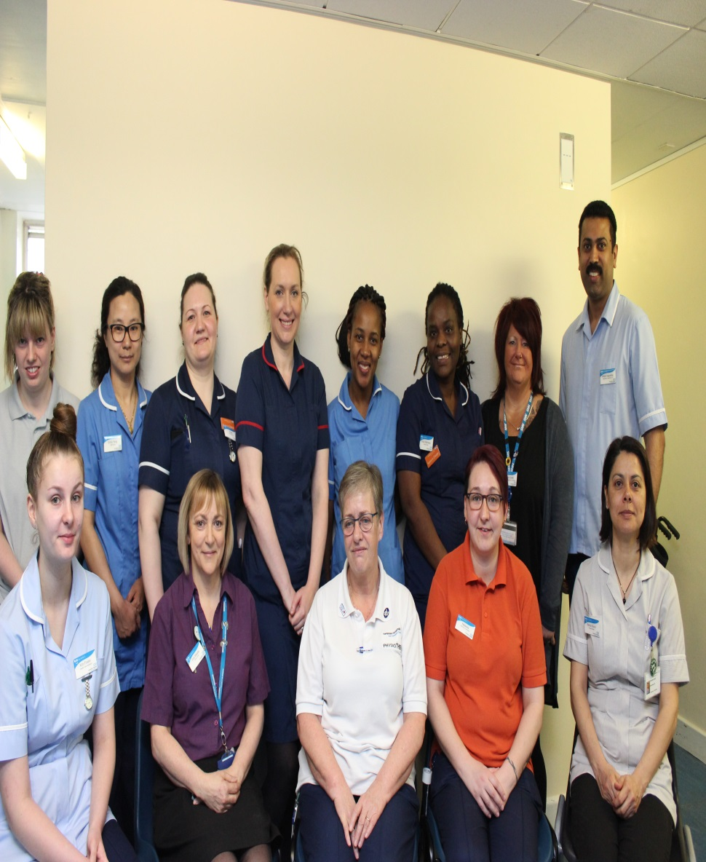
Project summary
Improved relations and communication with patients and relatives
Improved engagement from patient and relatives
Improved working relations and team morale
Decreased patient safety incidents
0 complaints
Improved recruitment and retention with 0 leavers

Slide 3
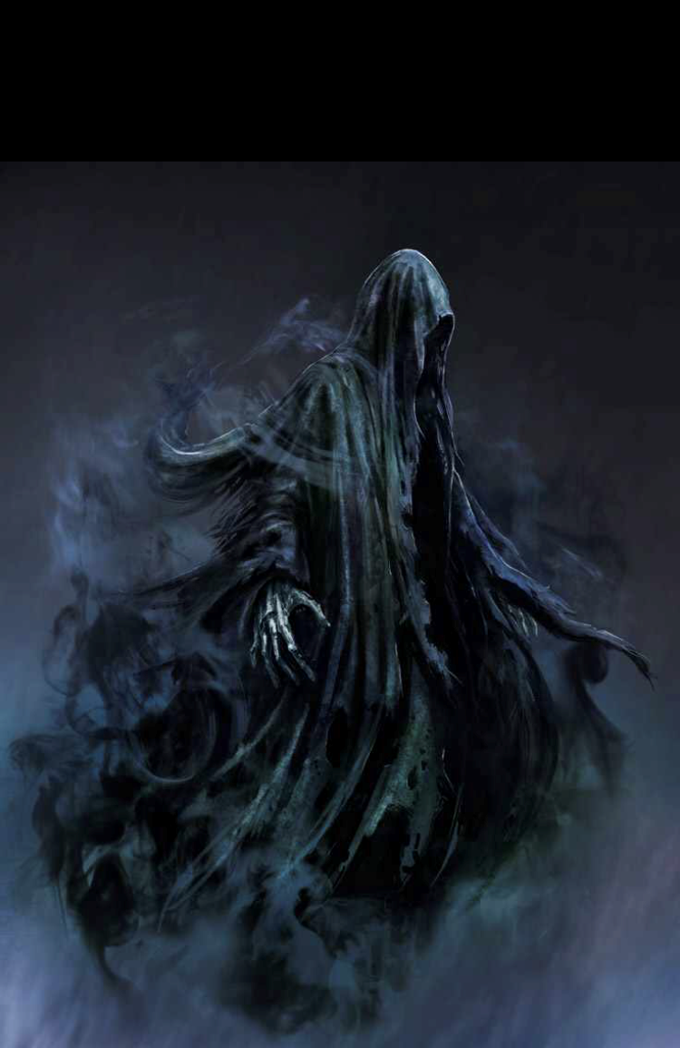
Background
Lack of leadership, multiple vacancies, acuity and dependency had led to low morale which in turn caused poor team culture. This was reflected in the following:
Complaints regarding care and communication
Poor retention and recruitment rates
Increased serious patient safety incidents
Negative reputation in the trust ‘you feel like the life is sucked out of you when you walk on that ward’

Slide 4

Introduction
When I (the project lead) was appointed as matron on the ward I knew of its reputation. Staff appeared to be broken, demoralised and really in need of some TLC
A whole new senior team was appointed which gave the team an initial boost but as time went on, old habits came back
The senior team were all strong believers in person centred care. I came up with the idea of trying to improve culture by empowering staff to be actively involved in decisions. I also believe that the key to culture change was the involvement of patients and relatives and so an application to FoNS and the Patients First Programme was made which was the start of our journey …

Slide 5
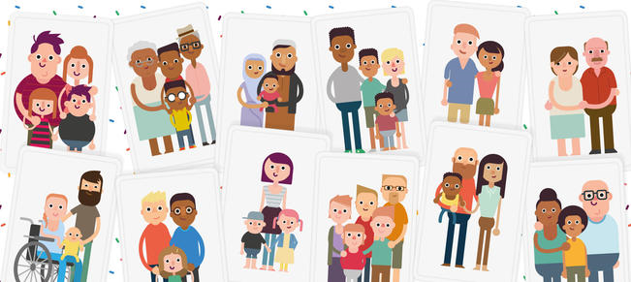
Aims
Improve team working by improving staff morale, team culture and collaborative working
To improve patient and relative experience
Reduce patient safety incidents

Slide 6
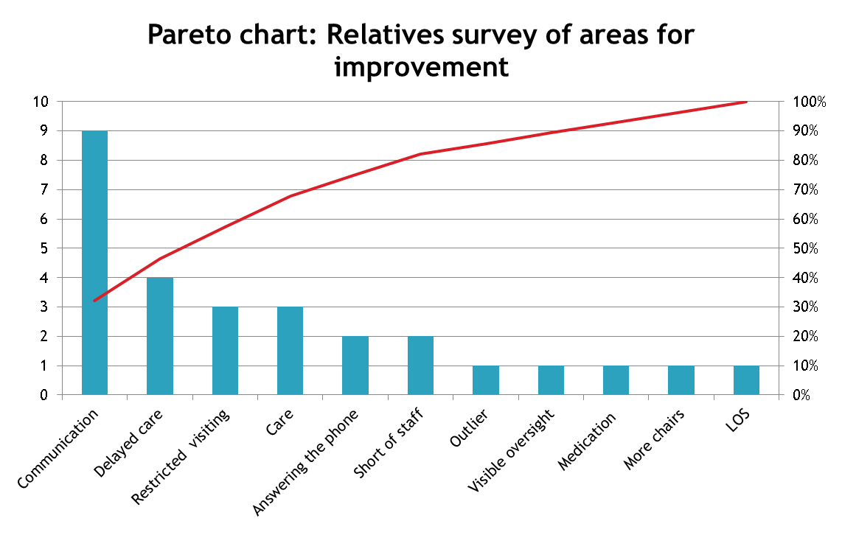
Methods and approaches(1)
Feedback was gained from patients, relatives and staff via questionnaires
From these, we were able to quantify and trend areas for improvement and concerns as per the Pareto chart below

Slide 7

Methods and approaches(2)
A ward meeting was held to feedback findings and gauge staff reaction
Staff were asked to volunteer if they would like to be part of the steering group that would analyse and make proposed changes

Slide 8
Methods and approaches(3)
A team culture tool (Pritchard and Dewing, 2000) was completed by each member of staff in order for us to gauge the feeling amongst the team and also to use as a measurement for the project.
Sept 2016 culture tool result (mean average)
A) People in my team have dissimilar values and interests and beliefs | 1 2 3 4 5 | People in my team share values, interests and beliefs
B) People in my team break rank and go it alone | 1 2 3 4 5 | People in my team pull together
C) Individuals in my team operate alone and there is conflict between them. | 1 2 3 4 5 | There is community spirit and co-operation in my team
D) My team is ruled by standards of the past | 1 2 3 4 5 | My team is ruled by visions of the future
E) Meetings are an aspect of the culture in my team | 1 2 3 4 5 | Working in small teams is an aspect of the culture in my team
F) In my team there are winners and losers, them and us | 1 2 3 4 5 | People confront and move beyond their differences in my team
G) My team is anti-change | 1 2 3 4 5 | My team is change orientated.
H) There is weak coordination in my team | 1 2 3 4 5 | There is strong coordination in my team
I) My team is inward-looking and is focused on itself | 1 2 3 4 5 | My team is outward-looking and does not focus on itself
J) My team is dominated by routine and systems | 1 2 3 4 5 | My team is creative and ideas-dominated
K) People do not reflect about their work in my team | 1 2 3 4 5 | People reflect about their work in my team
L) There is disagreement in my team | 1 2 3 4 5 | There is harmony in my team

Slide 9

Methods and approaches(4)
The main project team and steering group were invited to an away day to discuss and analyse the findings from the questionnaires and culture tool
Following this we were able to identify contributing factors to the problem

Slide 10
Methods and approaches(5)
A fishbone analysis was completed to understand the contributing factors to the problem

Slide 11

Outcomes/Finding/Evaluation(1)
Following the analysis and findings from the initial steering group away day, it was decided to go for some immediate changes to our practice
Open visiting was introduced to encourage families to contribute to people’s care as much as able

Slide 12
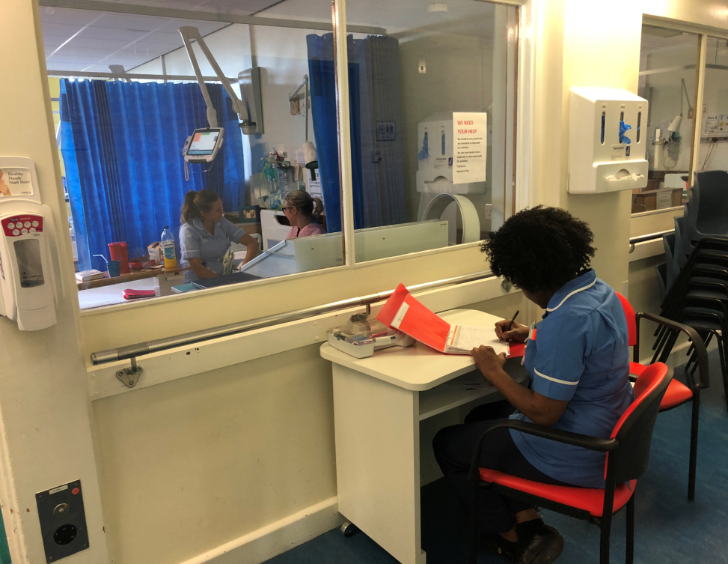
Outcomes / Findings / Evaluation(2)
Strict bay nursing was introduced. There would always be at least one member of staff in each bay. It was hoped that this would improve communication with patients and relatives and that patients’ needs would be met in appropriate time

Slide 13
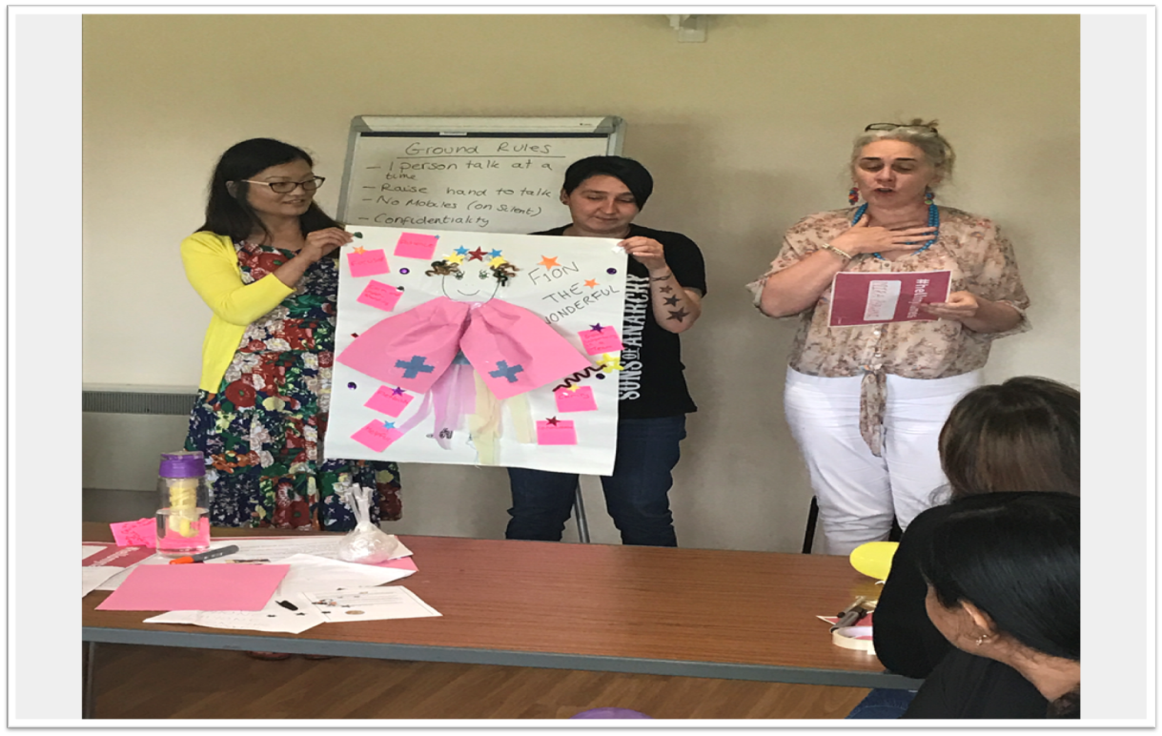
Outcomes/ Findings/ Evaluation(3)
A whole team away day was held
This was a fun day that truly united the team with a common vision
We looked at what would make a good team

Slide 14
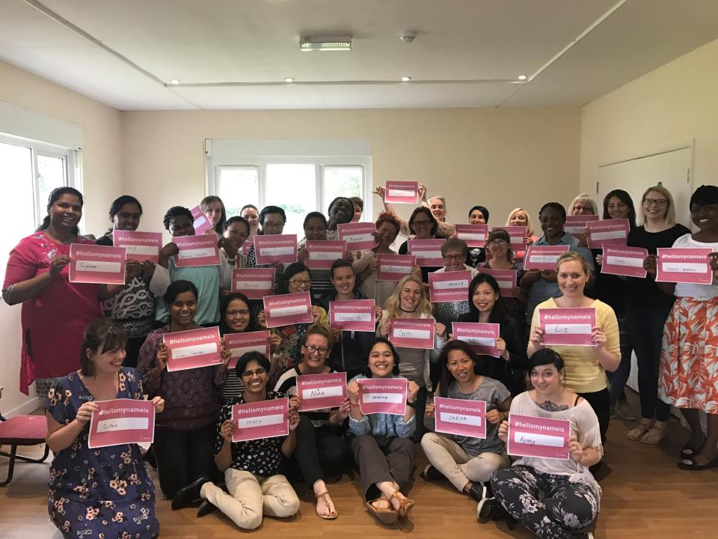
Outcomes/Evaluations/Findings(4)
At the away day we launched the hello my name is campaign
All members of the team were introduced to the idea and many gave examples of personal experience. Everyone was asked to pledge to undertake this individually. This is still being used one year on

Slide 15
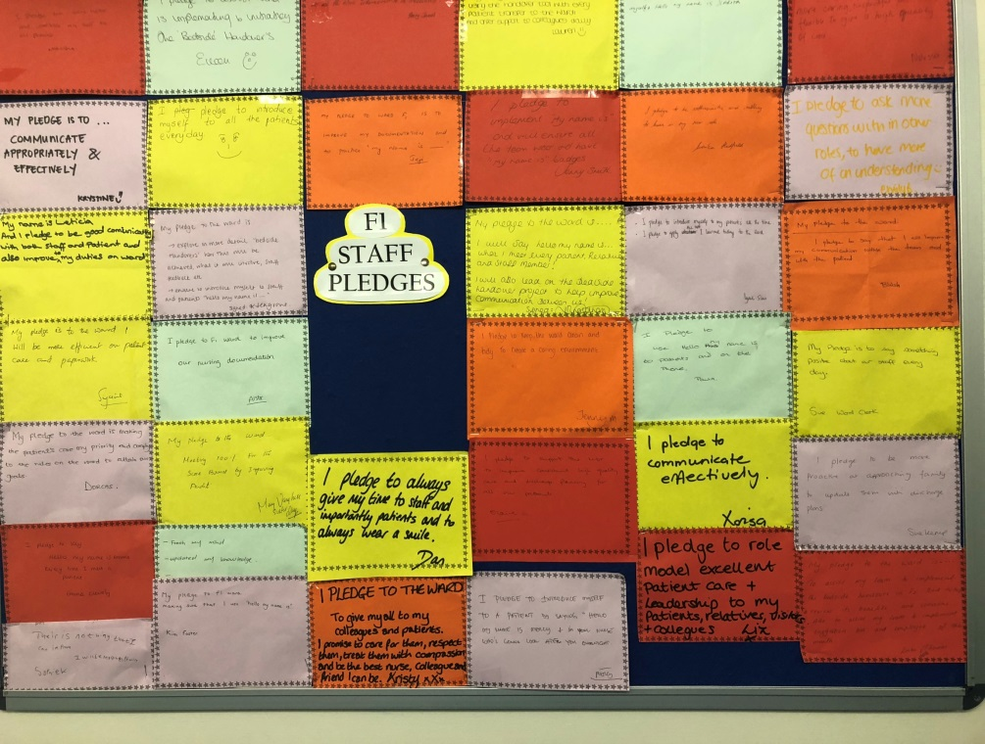
Outcomes/Findings/Evaluation(5)
At the end of the team away day, staff made pledges to the patients and the ward which are personalised and displayed for all visitors to the ward to see.

Slide 16
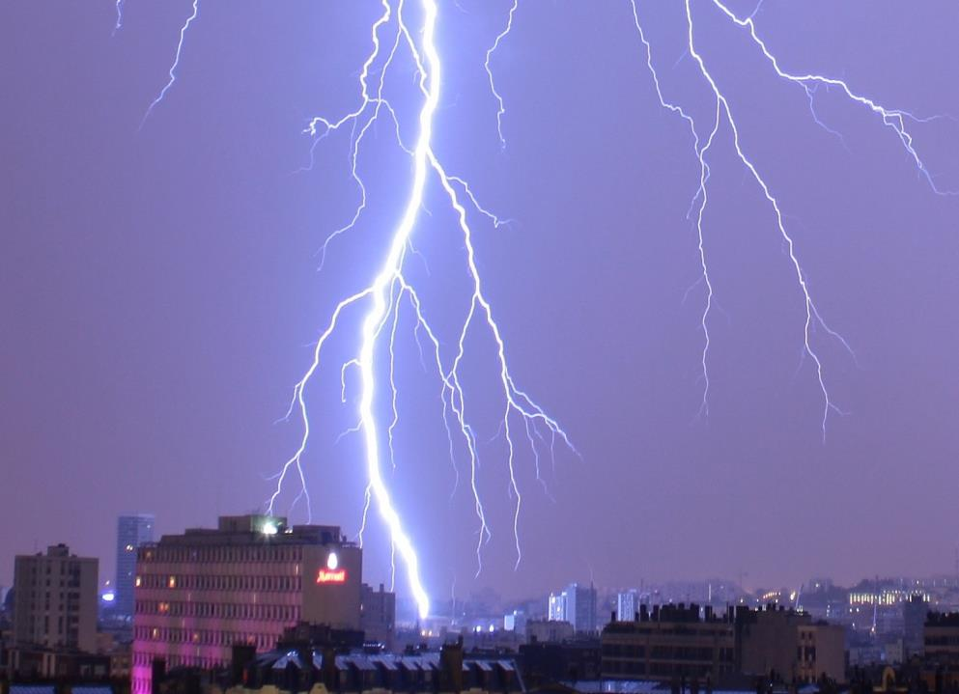
Discussion (1)
Following the away day, it was if a lightening bolt had struck. Everyone was full of positivity
We had a joint vision for the ward
Care, standards and team work improved

Slide 17
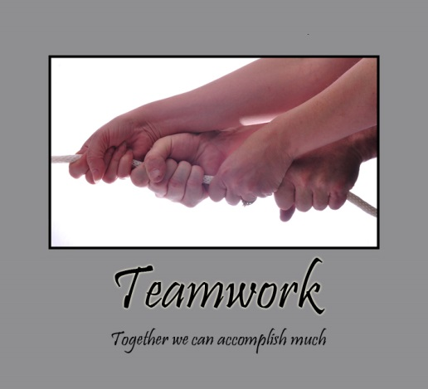
Discussion(2)
All team members became united and supported each other
Work was allocated and completed in a fair and timely manner
Patients and relatives appeared happier

Slide 18
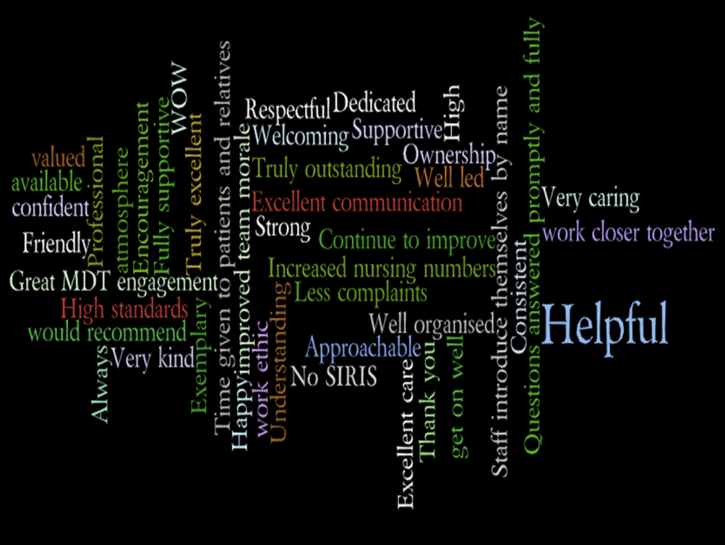
Discussion(3)
Patients, relatives and staff questionnaires were sent back out 4 months later with a 100% positive response.

Slide 19
Discussion(4)
The team culture tool was repeated with very positive results
A) People in my team have dissimilar values and interests and beliefs | 1 2 3 4 5 | People in my team share values, interests and beliefs
B) People in my team break rank and go it alone | 1 2 3 4 5 | People in my team pull together
C) Individuals in my team operate alone and there is conflict between them. | 1 2 3 4 5 | There is community spirit and co-operation in my team
D) My team is ruled by standards of the past | 1 2 3 4 5 | My team is ruled by visions of the future
E) Meetings are an aspect of the culture in my team | 1 2 3 4 5 | Working in small teams is an aspect of the culture in my team
F) In my team there are winners and losers, them and us | 1 2 3 4 5 | People confront and move beyond their differences in my team
G) My team is anti-change | 1 2 3 4 5 | My team is change orientated.
H) There is weak coordination in my team | 1 2 3 4 5 | There is strong coordination in my team
I) My team is inward-looking and is focused on itself | 1 2 3 4 5 | My team is outward-looking and does not focus on itself
J) My team is dominated by routine and systems | 1 2 3 4 5 | My team is creative and ideas-dominated
K) People do not reflect about their work in my team | 1 2 3 4 5 | People reflect about their work in my team
L) There is disagreement in my team | 1 2 3 4 5 | There is harmony in my team

Slide 20
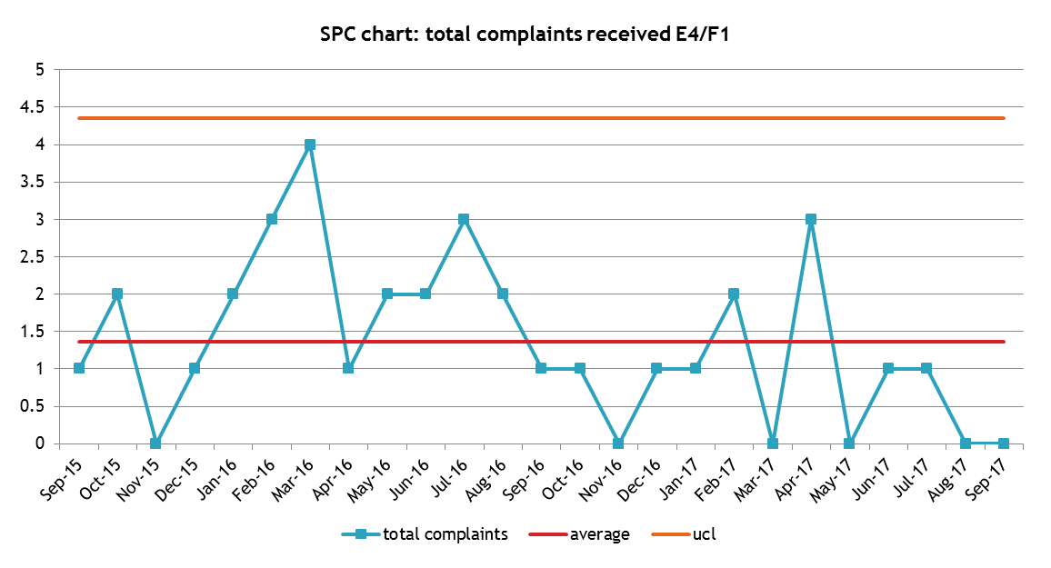
Conclusion(1)
Complaints reduced to 0
Falls reduced
Pressure ulcers reduced
Improved length of stay
Improved patient experience
Improved staff morale and teamwork

Slide 21
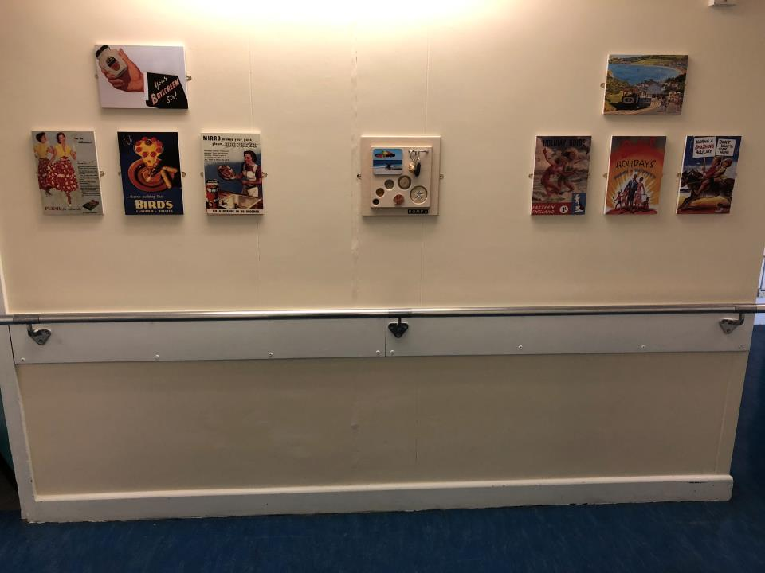
Conclusion(2)
The Patients First Programme has had a hugely positive impact on our team and the experience patients and relatives receive on our ward
The bursary has also enabled us to make our ward more dementia friendly

Slide 22
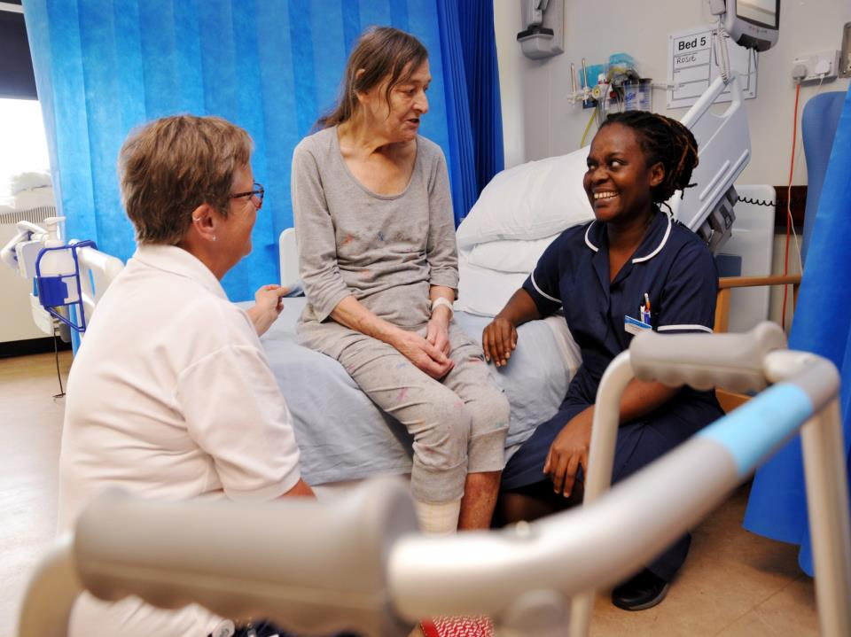
Conclusion(3)
We truly are a united multi disciplinary team that has patients at the centre of all the care we provide
Following the away day we have had team fund raising days
Team nights out which have all boosted morale and team work

Slide 23
Recommendations
Put yourself in the patient’s/relative’s shoes
Read ‘Running free’ (Kate Alloway)
Create the time to have a full team away day
Involve and empower your team to have ideas and use these ideas
Meet with patients and relatives regularly to receive feedback and pick up problems early
Empower and support junior staff to communicate with patients and relatives
Enjoy the work you do and appreciate your team individually

